Slide 1


Green Pace
Security Policy Presentation
Developer: Sean Bucklin

Slide 2

OVERVIEW: DEFENSE IN DEPTH
Software development at Green Pace requires consistent implementation of secure principles to all developed applications. Consistent approaches and methodologies must be maintained through all policies that are uniformly defined, implemented, governed, and maintained over time
The principles defined in this policy provide guidance on Green Pace’s values, objectives, and goals
This policy details how Green Pace with achieve these objectives and what is expected of every employee

Slide 3
THREATS MATRIX
Likely | Priority
Low priority | Unlikely
Injection Attack
Occurs when an outside actor feeds malicious commands into a subsystem
Buffer Overflow
Occurs when a program writes to more data than it was built to hold
Validate Input
Never trust outside data
Integer Overflow/Underflow
Occurs when a value exceeds the limits of the integer data type
Memory Leaks
Occurs when a user allocates memory but does not use it

Slide 4
10 PRINCIPLES
Validate Input Data
STD-004-CPP
Heed Compiler Warnings
STD-007
Architect and Design for Security Polices
STD-001-CPP, STD-003-CPP, STD-009-CPP, STD-010-CPP
Keep It Simple
STD-003-CPP, STD-005-CPP
Default Deny
STD-004-CPP
Adhere to Principle of Least Privilege
Sanitize Data Send to Other Systems
STD-004-CPP
Practice Defense in Depth
Use Effect Quality Assurance Techniques
STD-002-CPP, STD-006-CPP
Adopt a Secure Coding Standard
STD-001-CPP, STD-003-CPP, STD-008-CPP

Slide 5
CODING STANDARDS
Data Type [STD-001-CPP]
Copying data to a buffer that is not large enough to hold that data results in a buffer overflow
Data Value [STD-002-CPP]
Prevent the leak of or unauthorized access of sensitive data
String Correctness [STD-002-CPP]
Standard library functions such as ‘std:string’ is better than c-style styrings
SQL Injection [STD-004-CPP]
String data passed to complex subsystems may contain special characters that can trigger commands
Memory Protection [STD-005-CPP]
Accessing a pointer that has been deallocated by memory management is undefined behavior
Assertions [STD-006-CPP]
should not be used as a security measure
Exceptions [STD-007-CPP]
exceptions thrown are processed by the nearest handler with types that match the exception thrown
Input – Output [STD-008-CPP]
Release the system resources used by the file when they are no longer needed
Characters & Strings [STD-009-CPP]
Index operators are unchecked and could lead to range errors
Expressions [STD-010-CPP]
Variables assume unexpected values when accessed before initialization

Slide 6
ENCRYPTION POLICIES
Encryption in Rest
This is designed to ensure that if hackers access data on disk, it will be encrypted and unusable
Strong encryption standards should be adhered to, such as implementing AES or RSA encryption methods
Encryption keys should never be stored in the same location as the data
Encryption at Flight
This represents data being transferred over a network. Secure transfer protocols should always be used
SFTP should be used over the unsecure FTP
For web servers TLS / HTTPS should be used for all connections
Wherever possible avoid using self-signed certificates
Encryption in Use
In-use encryption helps keep data encrypted through the data’s entire lifecycle
All sensitive data remains encrypted with AES-256
Additional benefit of in-use encryption is that it can detect anomalies by analyzing requests and blocking suspicious activity.

Slide 7
TRIPLE-A POLICIES
Authentication
Authentication is the first layer of Triple-A and it’s the way that the application identifies a user
Authentication may be completed using username & passwords, single sign on (SSO), biometrics, digital certificates, and public key infrastructure
Good practice is to enforce two-factor authentication to add more defense in depth to authentication
Authorization
Administrators grant each user a certain level of access
Apply the principle of least privilege
Only users with administration level of access will be granted the ability to add new users and determine their level of access
Accounting
Allows administrators to audit the system
See what files were accessed by users within the system
After a user is logged in to the system all tasks performed by the user are logged to that user

Slide 8
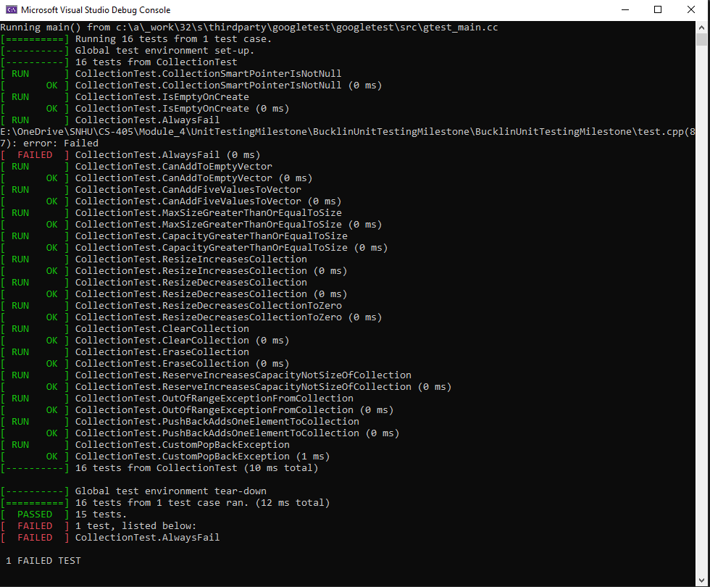
Unit Testing
Unit testing is a way to scrutinize each small unit of software for proper operation
Each unit can be tested to confirm conformance to security standards
Attached screenshot of the results from Google Test unit testing.

Slide 9

AUTOMATION SUMMARY

Slide 10
TOOLS
DevSecOps pipeline focus heavily on integrating tools and practices into the process of planning, building, testing, deploying, and monitoring software
Threat modelling during the design phase
Security Scanning and testing throughout development
Security analysis during the maintenance phase
Remediation addressing vulnerabilities discovered after deployment
Monitoring deployed systems
Static Testing Tools
Such as CPPCheck can be used during development to help identify vulnerabilities early
Source composition anylysis [SCA]
Scan dependencies and libraries for vulnerabilites

Slide 11
RISKS AND BENEFITS
Leaving security to the end does not have any benefits
One could wrongly argue that it speeds up development
Keeping security involved early ensures a more cost effective and secure software
By keeping security in mind throughout the DevSecOps lifecyle you inhertently build in a defense in depth strategy
Many defense in depth tactics such as Triple-A or Zero trust require a certain architecture that would be impossible to add later without great cost

Slide 12
RECOMMENDATIONS
This policy could benefit from the addition of more standards
In mapping standards to principles it became clear there aren’t enough standards for complete coverage of the principles
Review more common vulnerabilities, and identify more standards to prevent them
Review more DevSecOp tools and detail stricter guidelines on when and how they are to be used.

Slide 13
CONCLUSIONS
The proposed security policy should be adopted at Green Pace
The identified principles provide guidance on security goals
The identified standards provide clear steps to help achieve those goals
Adopting security early is crucial to successful software
Its very difficult to do so retroactively, and incurs great cost
This policy can provide clear guidance to all members of Green Pace and what is expected
Get everyone moving together in the same direction on security
Provide Defense In Depth

Slide 14
REFERENCES
Check Point. (2023, August 18). What is a DevSecOps Pipeline? Retrieved from Checkpoint: https://www.checkpoint.com/cyber-hub/cloud-security/devsecops/what-is-a-devsecops-pipeline/
GuardRails. (2023, April 27). The Top C++ Security Vulnerabilities and How to Mitigate Them. Retrieved from Security Boulevard: https://securityboulevard.com/2023/04/the-top-c-security-vulnerabilities-and-how-to-mitigate-them/#:~:text=5%20Common%20C%2B%2B%20Security%20Vulnerabilities,and%20use%2Dafter%2Dfree.

